Slide 1
Joining forces for green recovery and digital transition – creating synergies with Horizon Europe
Bulgaria Economic Forum 2020
„Economic recovery on the horizon”
Sven Schade
European Commission, DG R&I.A3
Horizon Europe Strategic planning

Slide 2
The „European Green Deal“ – An introduction Creating synergies between programmes

Slide 3
The European Green Deal
Transforming the EU’s economy for a sustainable future
Increasing the EU’s Climate ambition for 2030 and 2050
A zero pollution ambition
for a toxic-free environment
The
European Green Deal
Preserving and restoring ecosystems and biodiversity
Supplying clean, affordable and secure energy
Mobilising industry
for a clean and circular economy
From ‘Farm to Fork’: a fair, healthy and environmentally friendly food system
Building and renovating in an energy and resource efficient way
And leaving
no one behind
Accelerating the shift to sustainable and smart mobility
Our European Growth Strategy U. v.d. Leyen
Designing a set of
deeply transformative policies
The EU as a global leader
A European Climate Pact

Slide 4
The European Green Deal
17-12-19 Annual sustainable growth strategy
Transforming the EU’s economy for a sustainable future
Increasing the EU’s Climate ambition for 2030 and 2050
A zero pollution ambition
for a toxic-free environment
The
European Green Deal
Preserving and restoring ecosystems and biodiversity
Supplying clean, affordable and secure energy
Mobilising industry
for a clean and circular economy
From ‘Farm to Fork’: a fair, healthy and environmentally friendly food system
Building and renovating in an energy and resource efficient way
And leaving
no one behind
Accelerating the shift to sustainable and smart mobility
14-01-20 Green Deal Investment Plan incl Just Transition Fund
Designing a set of
deeply transformative policies
The EU as a global leader
A European Climate Pact

Slide 5
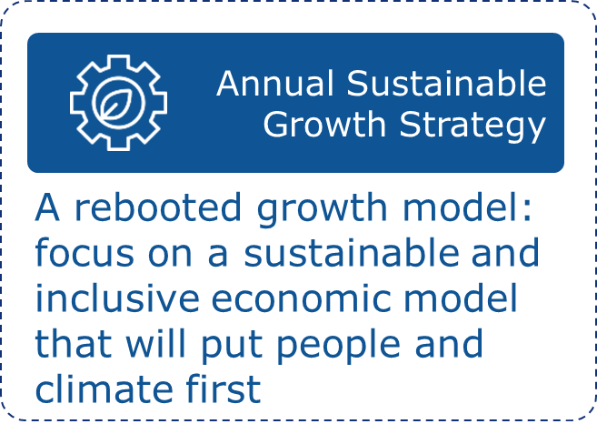
Annual sustainable growth strategy: A new economic narrative
Main tool for setting the general economic and employment priorities for the EU at the beginning of each European Semester cycle
Notes:
From AGS 2019:
Since ex-President Juncker took the office, the three main pillars for the EU’s economic and social policy have been a coordinated boost to investment, a renewed commitment to structural reforms, and the pursuit of responsible fiscal policies. In line with the Integrated Guidelines, these elements have formed a virtuous triangle, which has helped reinforce the recovery and support the economic growth.
Since 2018 the European Pillar of Social Rights in place. The Pillar of Social Rights is about delivering new and more effective rights for citizens. It builds upon 20 key principles, structured around three categories:
1. Equal opportunities and access to the labour market (principles: Gender equality, Education, training and life-long learning, Equal opportunities, Active support to employment )
2. Fair working conditions (principles: Secure and adaptable employment, Wages, Information about employment conditions and protection in case of dismissals, Social dialogue and involvement of workers, Work-life balance, Healthy, safe and well-adapted work environment and data protection)
3. Social protection and inclusion (principles: Childcare and support to children, Social protection, Unemployment benefits, Minimum income, Old age income and pensions, Health care, Inclusion of people with disabilities, Long-term care, Housing and assistance for the homeless, Access to essential services)
The biggest novelty in ASGS: environmental sustainability.
From the ASGS:
Environmental sustainability, productivity gains, fairness and macro-economic stability will be the four dimensions of our economic policy in the years to come. These dimensions, which are closely interrelated and mutually reinforcing, should guide structural reforms, investments and responsible fiscal policies across all Member States.
These four key dimensions will be crucial in implementing the Sustainable Development Goals (SDGs). Integrating the objectives of the SDGs in the European Semester, with a specific focus on the economic and employment aspects, provides a unique opportunity to put people, their health and the planet at the centre stage of economic policy. In today’s geopolitical context, putting the SDGs at the centre of the Union’s policymaking and action also sends a strong message about Europe’s commitment towards sustainability.
To succeed, costs and benefits need to be balanced in the short and long term. Benefits should be shared and costs must not be borne by the most vulnerable. Both climate change itself and the flanking policies required to overcome the challenges it creates have significant distributional consequences, especially in the short term. When designing policies and formulating recommendations for structural reforms, we need to ensure that support for the people most affected by these societal changes is put in place. On the other hand, the green transition will also create new jobs and greater well-being, for example in the form of healthier working and living environments. Also in other policy areas, short term trade-offs exist. For example, when it comes to seeking a more inclusive growth, the labour market integration of more lower-skilled workers may reduce average productivity in the short-term. This, however, does not change the long-term advantage of labour market integration contributing to a more balanced and prosperous society over time. To maximise synergies between the various policy goals outlined, significant public and private investments will be needed, for example in education, retraining and innovation

Slide 6
The European Green Deal
17-12-19 Annual sustainable growth strategy
04-03-20 Climate Law proposal
14-10-20 Chemicals strategy
Transforming the EU’s economy for a sustainable future
Increasing the EU’s Climate ambition for 2030 and 2050
A zero pollution ambition
for a toxic-free environment
08-07-20 Hydrogen Strategy
The
European Green Deal
Supplying clean, affordable and secure energy
Preserving and restoring ecosystems and biodiversity
20-05-20 Biodiversity and ‚Farm to Fork‘ strategies
10-03-20 Industry str. / Circular Economy Action Plan
Mobilising industry
for a clean and circular economy
From ‘Farm to Fork’: a fair, healthy and environmentally friendly food system
Building and renovating in an energy and resource efficient way
And leaving
no one behind
Accelerating the shift to sustainable and smart mobility
14-10-20 Renovation wave for Europe
14-01-20 Green Deal Investment Plan incl Just Transition Fund
In the Commission work programme 2021
Designing a set of
deeply transformative policies
The EU as a global leader
A European Climate Pact

Slide 7
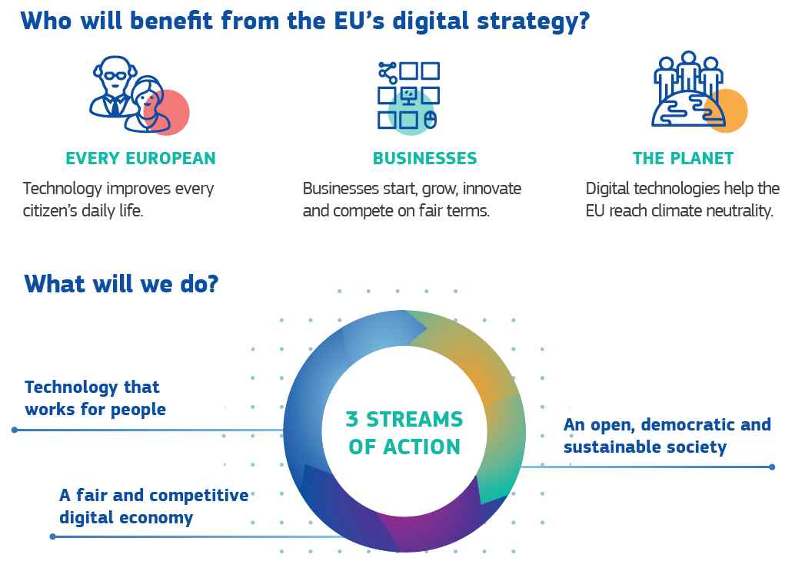
Shaping Europe's digital future – 19/02/2020

Slide 8
Policy initiatives and funding programmes – what‘s next?
Legislative initiatives
Go through discussions in EP and Council – see Climate law agreement in EP, yet no position in Council
Many concrete initiatives to be launched in 2021/22, presented to EP And Member States and conclude within the mandate of the Commission (2024)
Financing programmes
Direct impact on priorities of programmes 2021-27 – even if proposal were drafted earlier
No agreement on ‚Multiannual Financial Framework‘ and ‚Recovery and Resilience Fund‘ (€750Mrd – 40% Green Transformation)
Independent investment strategy of EIB (new ‚Climate bank‘)

Slide 9
Supporting innovation and a transformation of society

Slide 10
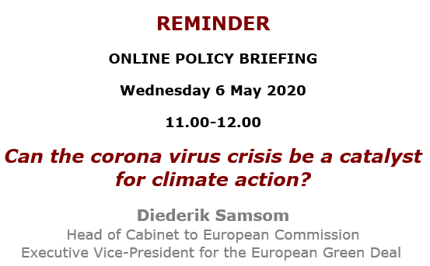
COVID- crisis recovery: ‚Back to normal‘ or ‚Renewal & jump forward‘?
Proposals for Revised proposal for MFF 2021-27
€1100billion
And
Next Generation EU
recovery instrument of €750 billion (4 years) – 40% target sustainability transition
But how?

Slide 11
Pillar 2 - Clusters Global challenges and industrial competitiveness
6 Clusters – +50% of Horizon Europe budgets of total <100bn/7 years
Digital, Industry and Space
Civil security for society
Health
Food, bioeconomy, natural resources, agriculture and environment
Culture, creativity and inclusive society
Climate, energy and mobility
Notes:
The second pillar focuses on Global Challenges and European Industrial Competiveness (named Global Challenges and Industrial Competiveness in the Commission Proposal). With a proposed budget of € 52.7 billion, it's designed to fund research and innovation tackling societal challenges and reinforce technological and industrial capacities.
This pillar contains six clusters that address the full spectrum of global challenges, as seen on the slide. The integration in clusters is designed to incentivise a systemic approach with cross-disciplinary, cross-sectoral, cross-policy and international collaboration, thereby achieving higher impact and better seizing the innovation potential that is often greatest at the intersection of disciplines and sectors. Here we also introduce an important novelty of Horizon Europe: the research and innovation missions (see section 'What is new').
As part of this pillar, Horizon Europe will also fund activities pursued by the Joint Research Centre, which supports EU and national policymakers with independent scientific evidence and technical support.

Slide 12
A Climate Resilient Europe - Prepare Europe for climate disruptions and accelerate the transformation to a climate resilient and just Europe by 2030
Mission Starfish 2030: Restore our Ocean and Waters
Conquering Cancer: Mission Possible
From ‘mission areas’ to Missions
Caring for Soil is Caring for Life
100 Climate-Neutral Cities by 2030 - by and for the citizens
Notes:
EP and Council had settled 5 areas for possible missions and given the task to define the missions in the strategic planning process. The mission identification was spearheaded by the mission boards, one for each mission area. The mission boards interacted closely with Member States, Parliament and a wide range of stakeholders, in order to facilitate the co-design of missions.
In particular the mission area „climate-neutral cities“ was very active in searching for direct contact with urban dwellers including the youth to get inspiration for the missions strategy.
In September this year the mission boards provided their recommendation for concrete mission – which you can see on the slide.
It is very important to reiterate that the missions are not meant as isolated research and innovation endavours to be ldealt with by research and innovation policy. Any of the missions can only succeed if there is wide understanding and engagement in taking the innovation solutions develop by research and innovation as inspiration for the relevant policy areas – be they spatial planning, preventive health care or international maritime policy.

Slide 13
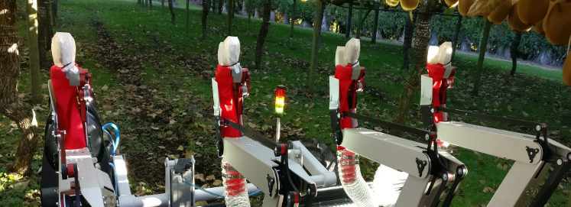
Embracing ‚transitions‘ in Horizon, Cohesion and Recovery funding
Innovating technologies or ‚innovating socio-technological systems‘? – regional value chains
R&I ‚Impact pathways‘ in the twin transition – High tech has catalyst for transformation ‘precision agriculture’ & competitive sustainability
The Citizen & innovation
The local face of SDGs A ‘just transition’ ! Citizen Science ‘testbeds’ – living labs

Slide 14
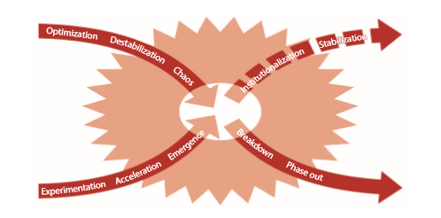
Transitions need comprehensive support
Horizon Europe
Transnational excellence for tech development (niche) & networking; further from commercial investment (longer timeframes)
Recovery funding & InvestEU
System transition in the region
Cohesion & Just transition fund
Deliberation, conflict avoidance & resultion, strategic investment
Derk Loorbach, Niki Frantzeskaki, and Flor Avelino Sustainability Transitions Research: Transforming Science
and Practice for Societal change; Annu. Rev. Environ. Resour. 42 (1), 599–626

Slide 15
Collaborate ! Thank you
© European Union 2020
Unless otherwise noted the reuse of this presentation is authorised under the CC BY 4.0 license. For any use or reproduction of elements that are not owned by the EU, permission may need to be sought directly from the respective right holders.
Slide xx: element concerned, source: e.g. Fotolia.com; Slide xx: element concerned, source: e.g. iStock.com
Notes:
Update/add/delete parts of the copy right notice where appropriate.
More information: https://myintracomm.ec.europa.eu/corp/intellectual-property/Documents/2019_Reuse-guidelines%28CC-BY%29.pdf

